Slide 1
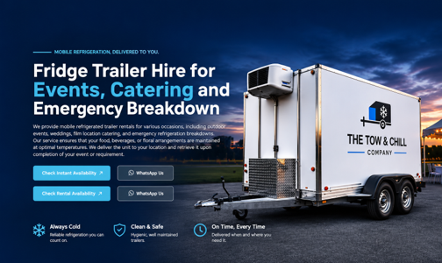
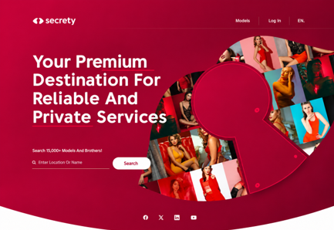
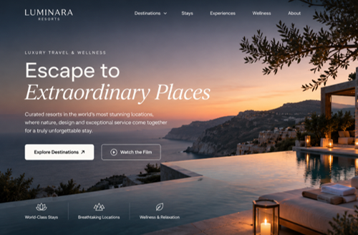
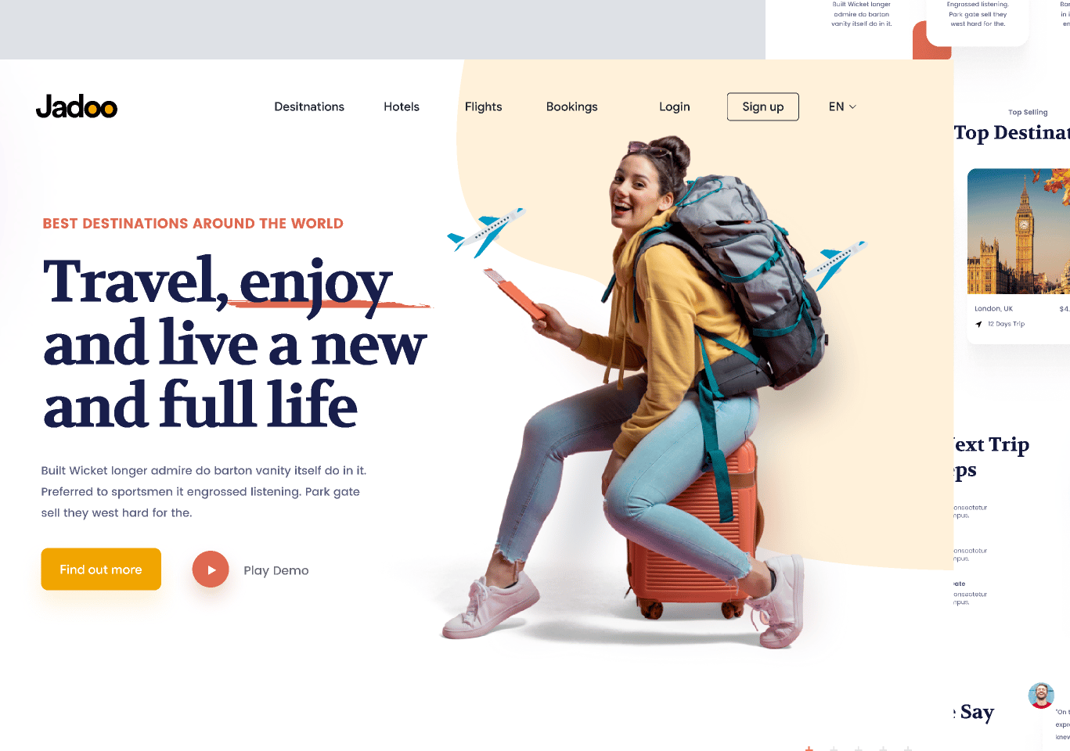
The problem
Original problem statement and supplied examples of conventional landing pages
Most websites and digital experiences are static, generic and they lack interactivity for users.
When businesses try to communicate their service, they struggle to present their products and services in engaging and memorable ways.
Also, it is difficult to find trustworthy creative providers who deliver high-quality experiences.
AVERNA • 01 / 06

Slide 2
Why it matters
Your original reasoning, retained without added claims
AI has now made conventional digital content easier to produce increasing the competition, presentation will become saturated and will be harder for businesses to differentiate.
Poor presentation can reduce customer interest, trust and engagement.
However, introducing 3D interactive experiences, adding another layer can improve product and understanding, customer engagement and brand memorability.
Businesses are already investing in these experiences.
AVERNA • 02 / 06

Slide 3
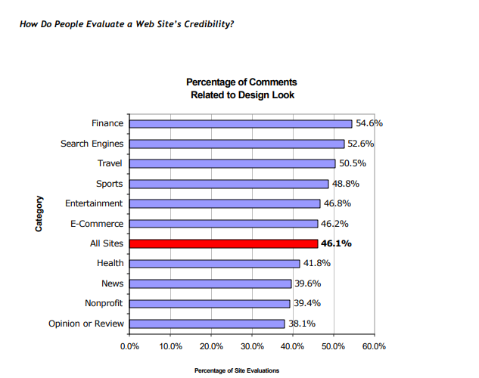
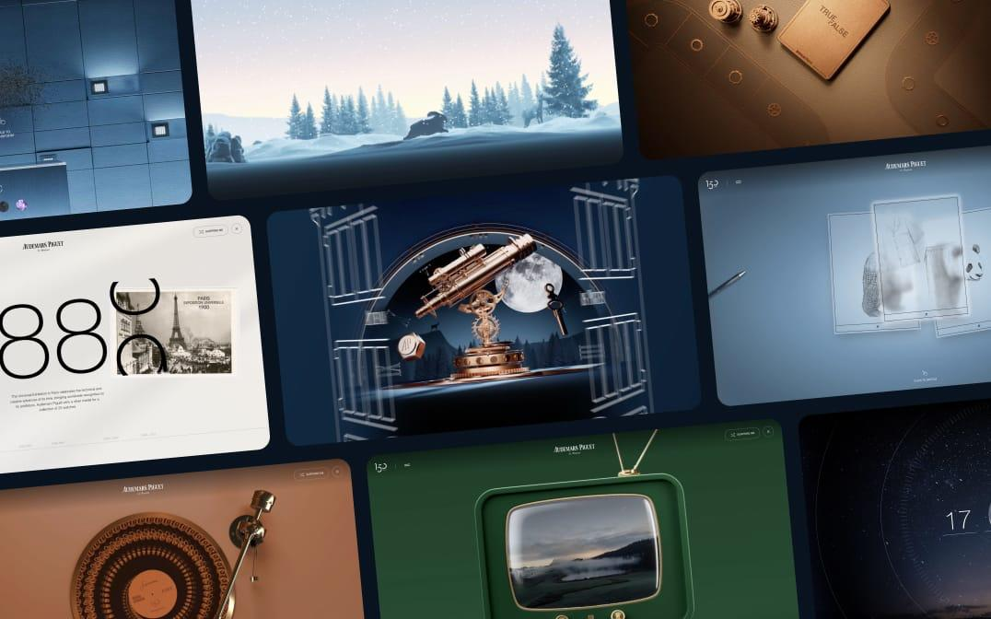
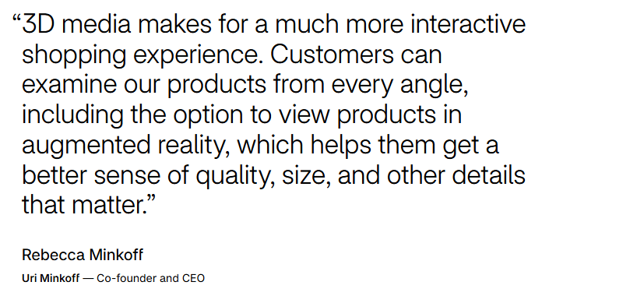
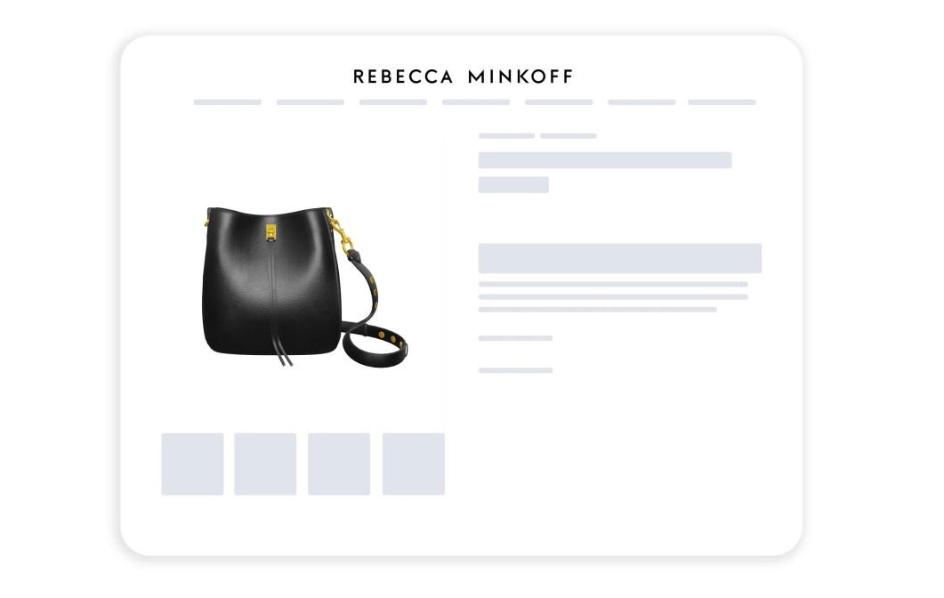



Why it matters
Your original reasoning, retained without added claims
Audemars Piguet
https://www.makemepulse.com/case-study/audemars-piguet-the-house-of-wonders?
Rebecca Minkoff
https://credibility.stanford.edu/pdf/How_Do_People_Evaluate_a_Web_Site%27s_Credibility_v37.pdf?
AVERNA • 02 / 06
https://www.shopify.com/my-ms/case-studies/rebecca-minkoff?

Slide 4
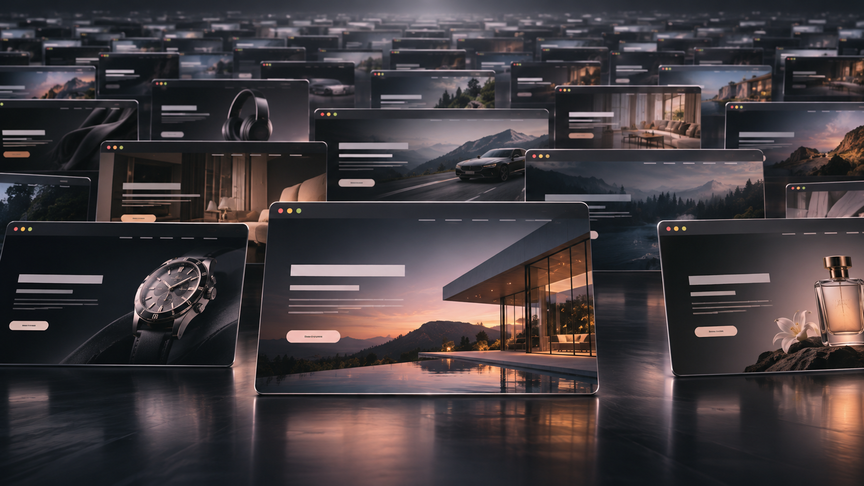

Slide 5
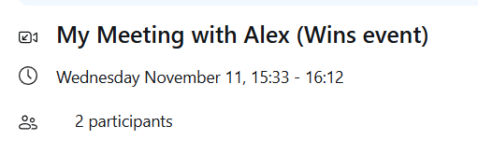
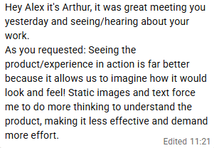
Business owner Feedback
Your interview summary, meeting evidence and Arthur’s message
Interview summary
“The question is whether that interaction helps the business achieve its goal.”
“You need to understand how that brand’s customers actually want to explore and buy its products, so it is to work backwards to the customers perspective.”
“Try the interactive element with a selected product category, see how it works, and consider expanding it later if it does have commercial success.”
“It depends massively on the business and the use case, which influences the level of interactivity needed .”
“The hybrid model works the best, combining the conventional idea for users who either prefer interactive or standard, and controlling the level of interactivity depending on business.
“Interactivity doesn’t have to be constantly excessive for every business.’”
“Make sure the site remains functional—especially on mobile.”
AVERNA • 06 / 06

Slide 6
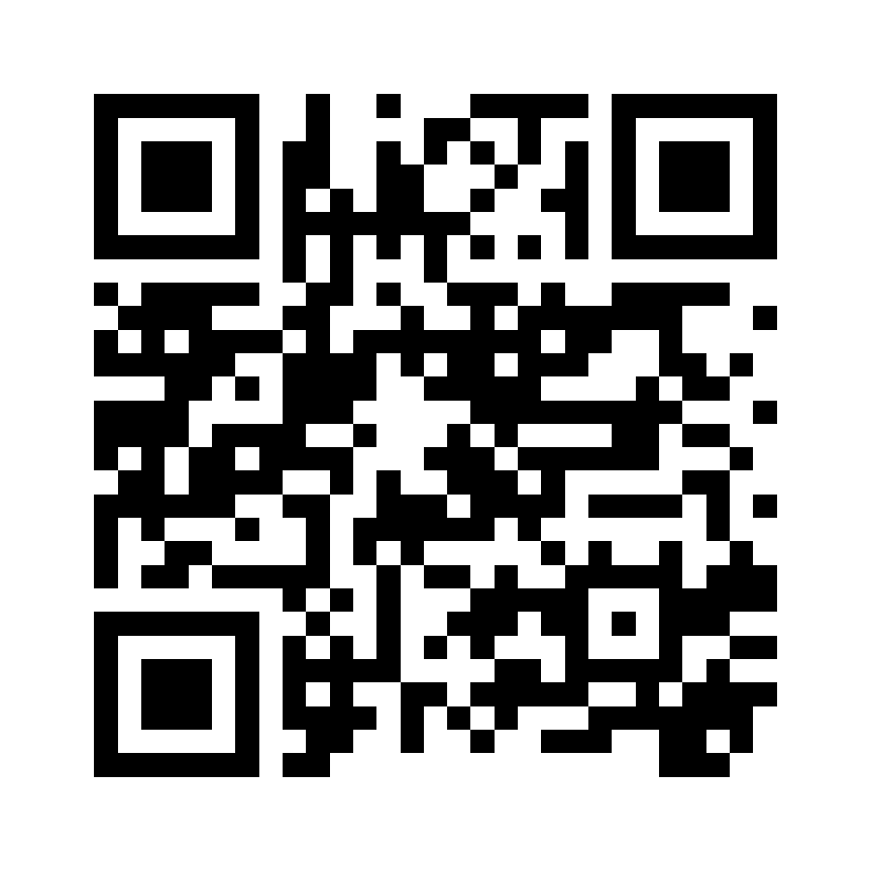
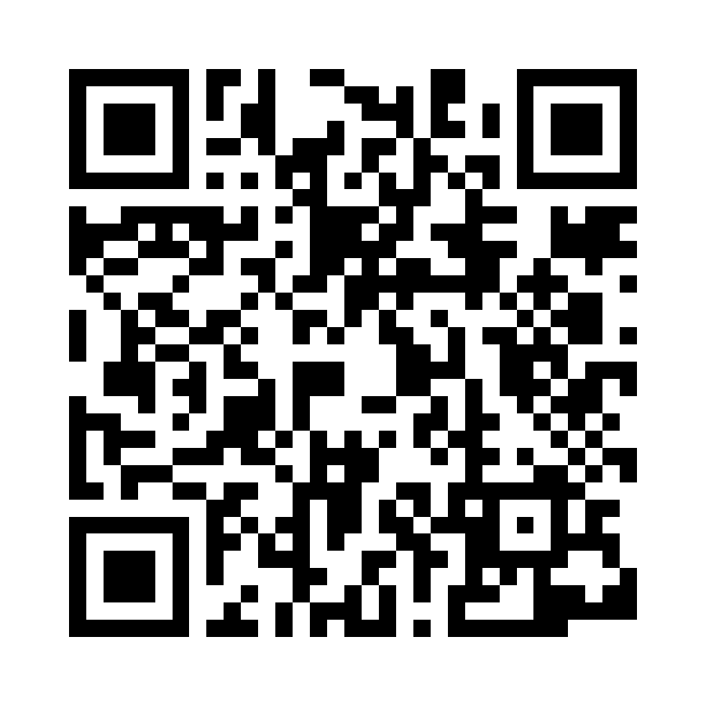
Nocturne: two landing pages, consumers
Comparison sent to approximately 60 people; all responded
~70%
~30%
Website 1 — interactive
Website 2 — conventional
Questions asked:
1. Which website is more fun and engaging to use, and why?
2. Which website makes you more interested in the product, and why?
3. Is there anything you don’t like about either website, what could be better?
Most replies simply selected Website 1 or Website 2. The ~70/30 split is your approximate result.
AVERNA • 04 / 06

Slide 7
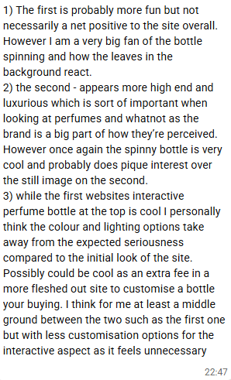
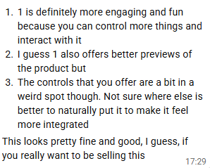
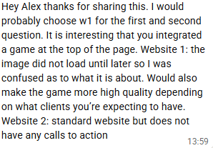
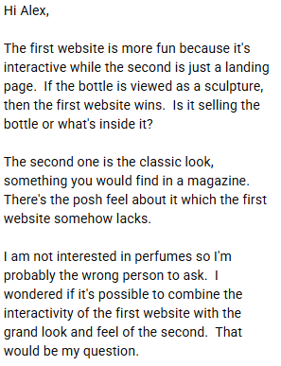
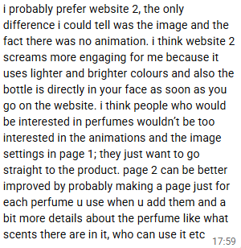
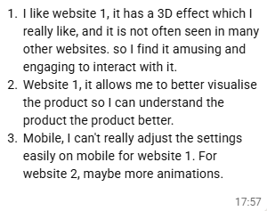
What respondents actually said
Original screenshots — presented without rewriting the responses
Additional respondent screenshot included on the following slide.
AVERNA • 05 / 06

Slide 8
Who I want to work with
Target customers — your wording
I want to work with visually driven businesses, not every business because it is not needed.
These are businesses where visual presentation plays a significant role in attracting customers, clients, communicating value and influencing purchasing decisions.
So, they want to improve what they communicate, differentiate themselves from competitors with high-quality digital experiences adding another layer for their users.
Initially I am working across multiple industries right now, I am still trying to look which customers benefit most from what I offer.
AVERNA • 03 / 06

Slide 9
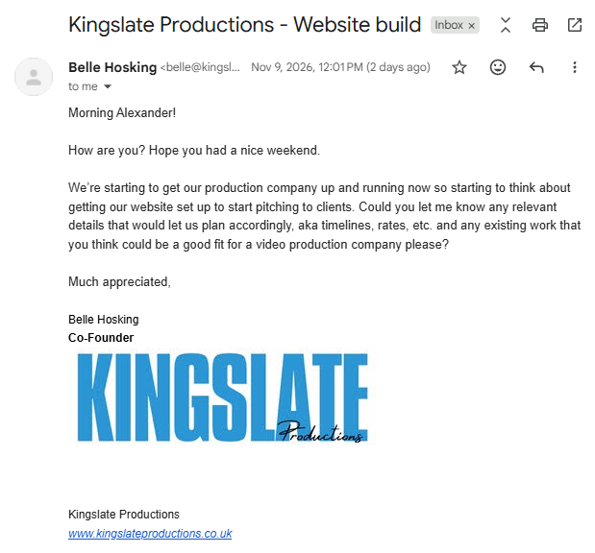
Who I want to work with
Target customers — your wording
Context?
This was someone I met from a networking event in Soho House, she was interested with the specific work I produced and the email is her reaching out.
What I have learnt from this?
There is potential commercial demand for the creative websites and interactive experiences I produce.
My work could be particularly valuable to businesses looking to showcase their portfolios, impress prospective clients and stand out from competitors.
AVERNA • 03 / 06

